Slide 1
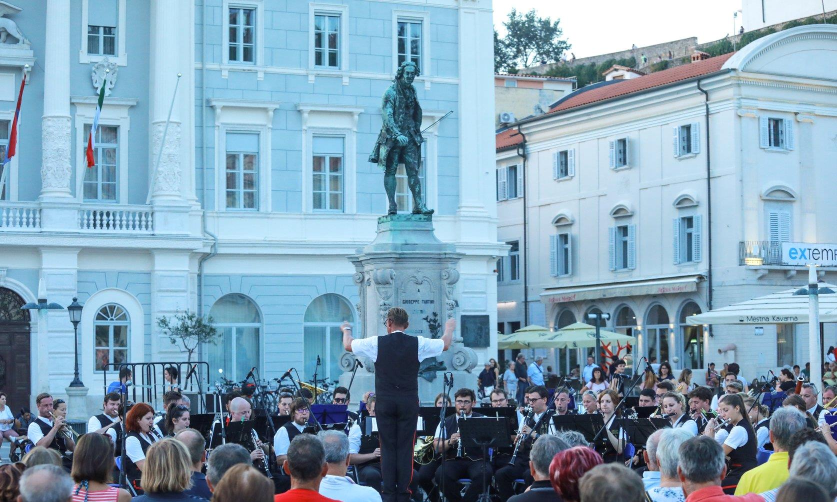
Giuseppe Tartini
OŠ Cirila Kosmača Piran
4. B

Slide 2
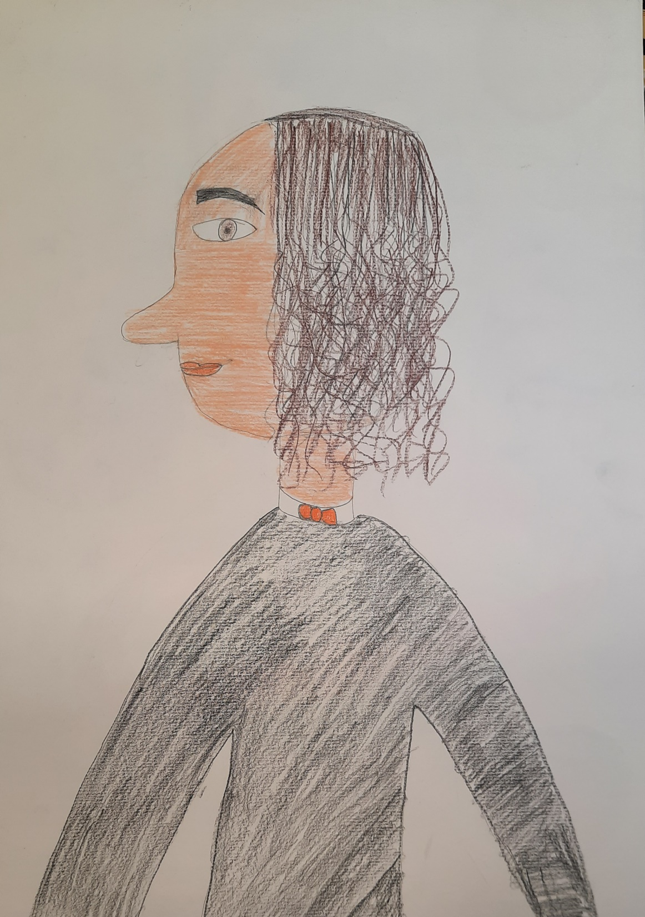
Giuseppe Tartini was a composer and violinist.

Slide 3
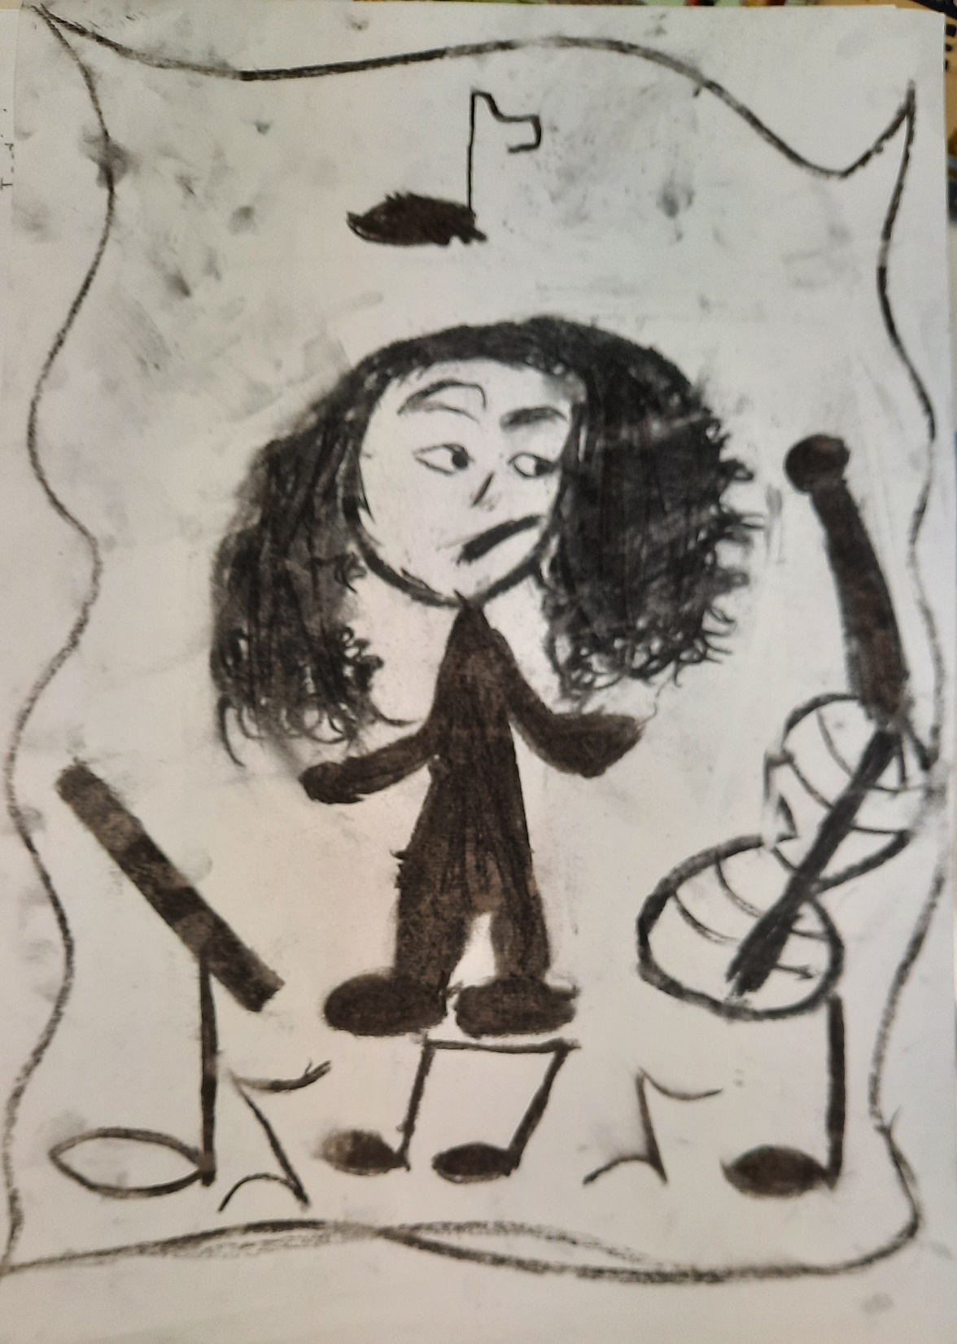
He was born on 8th April 1692 in Piran.

Slide 4
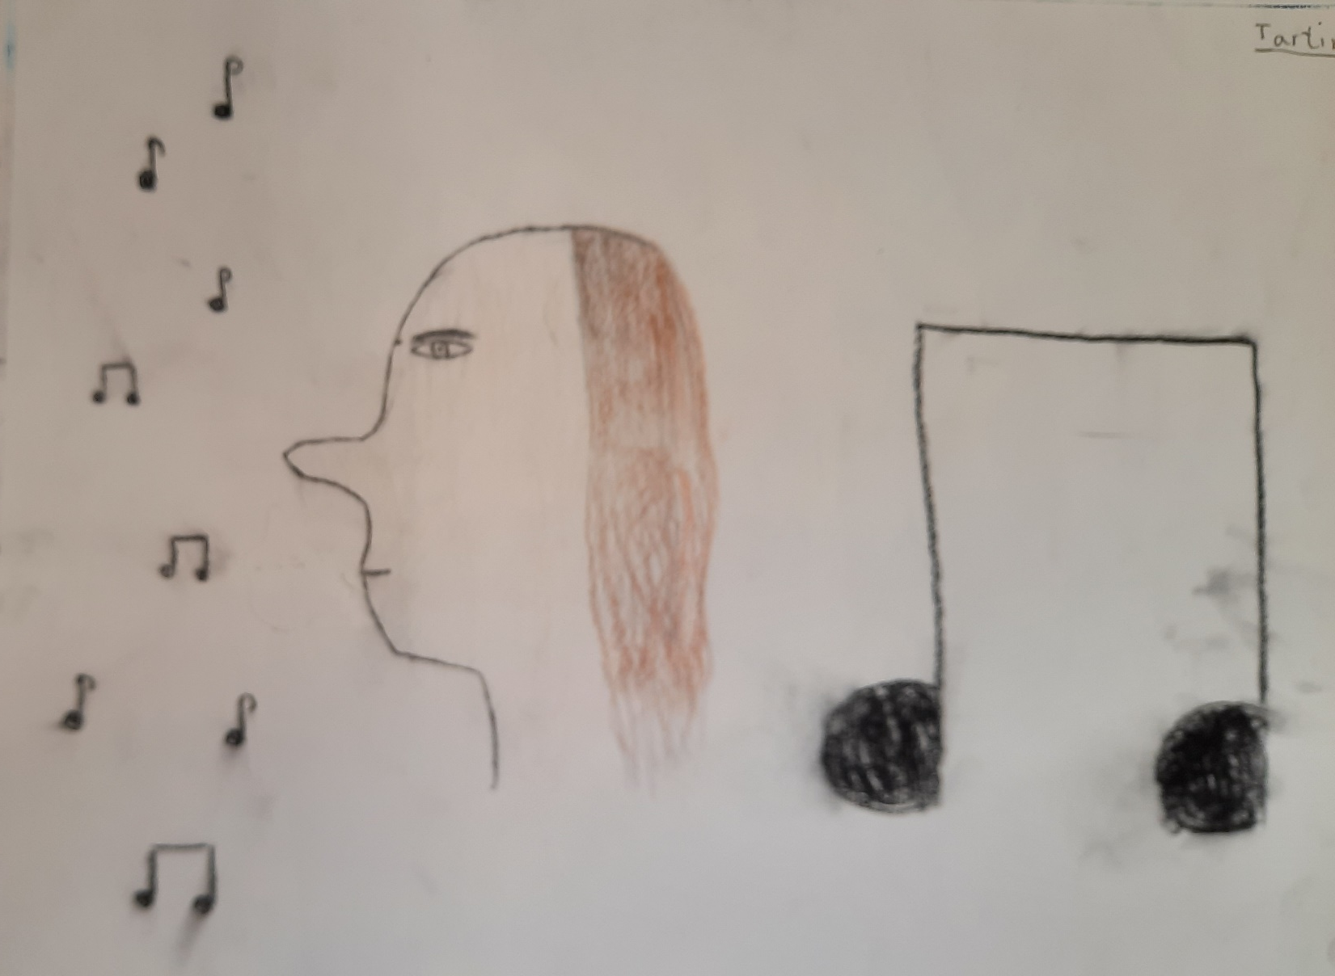
He studied law at the University of Padova in Italy.

Slide 5
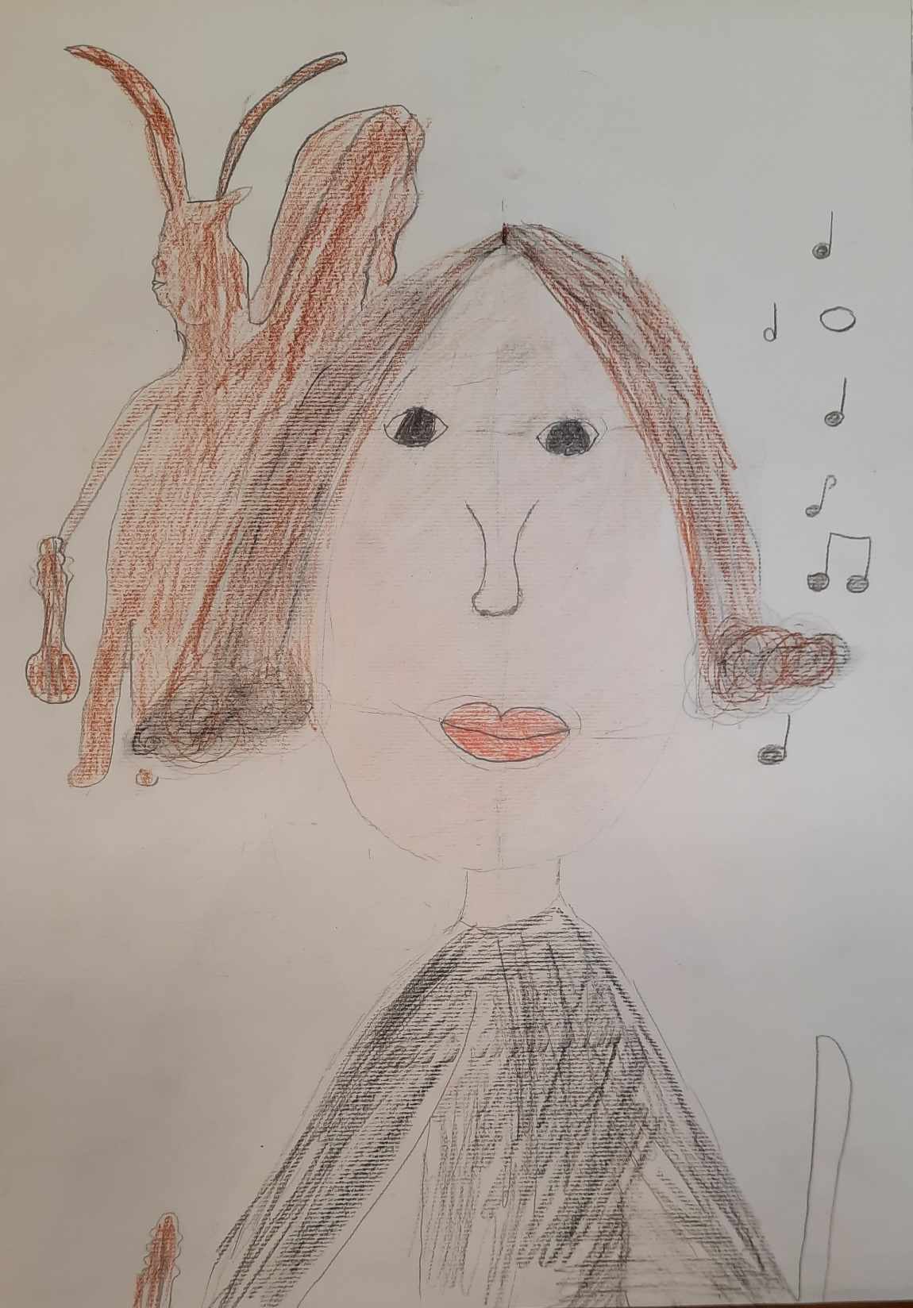
Tartini's most famous work is the "Devil's Trill Sonata„.

Slide 6
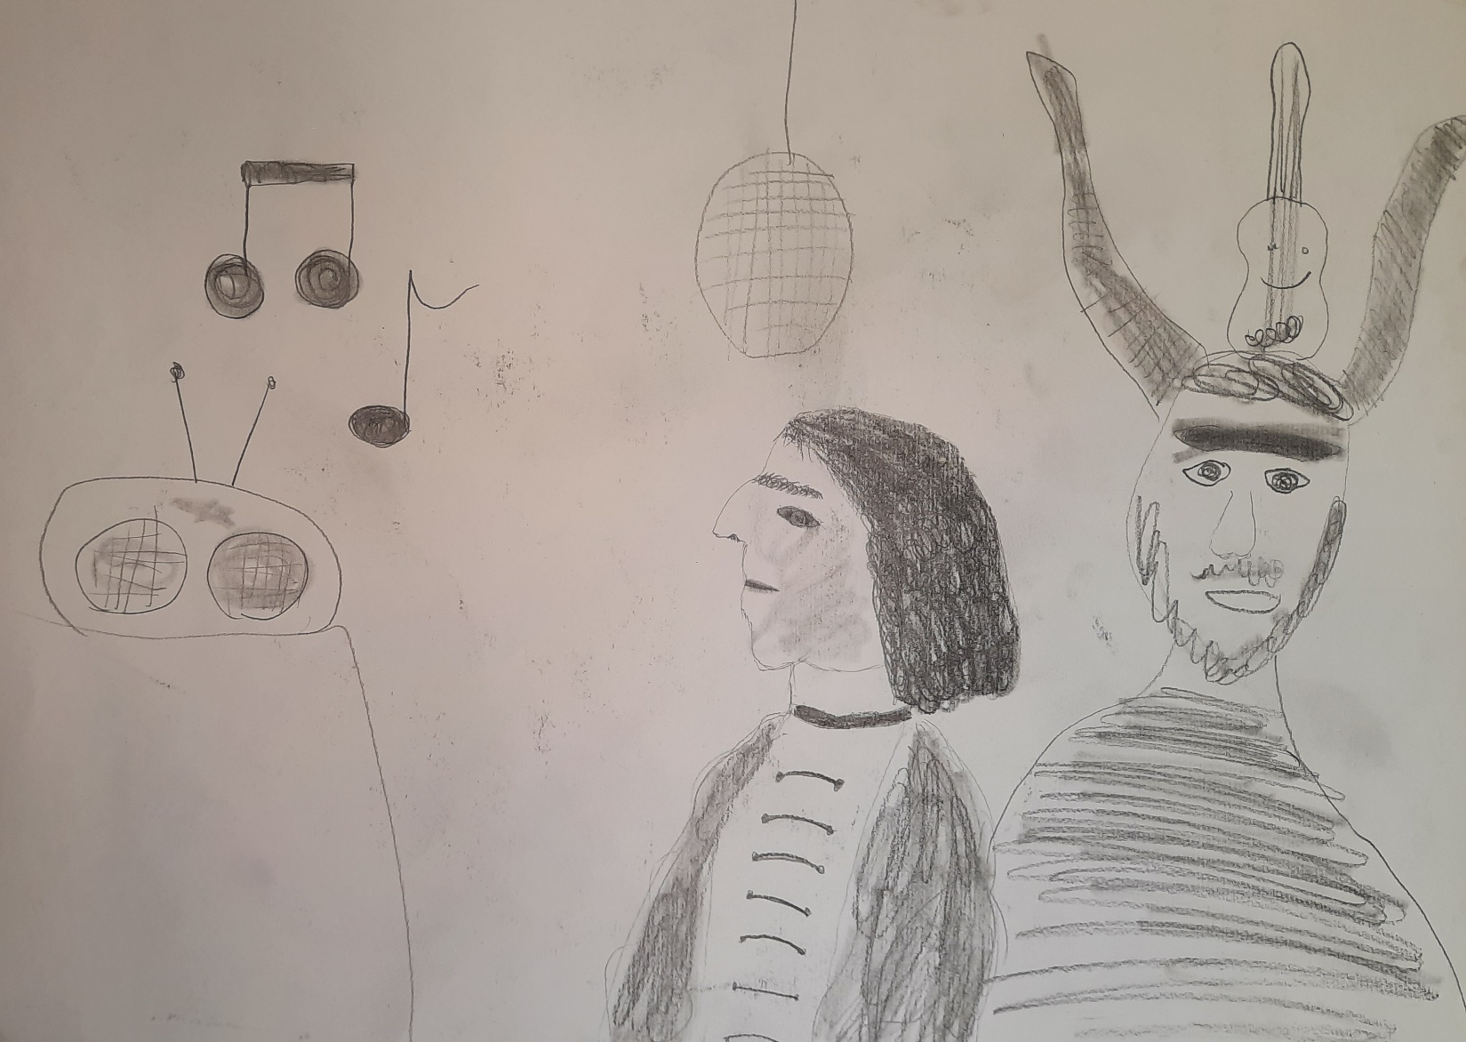
He was inspired to write the sonata by a dream.

Slide 7
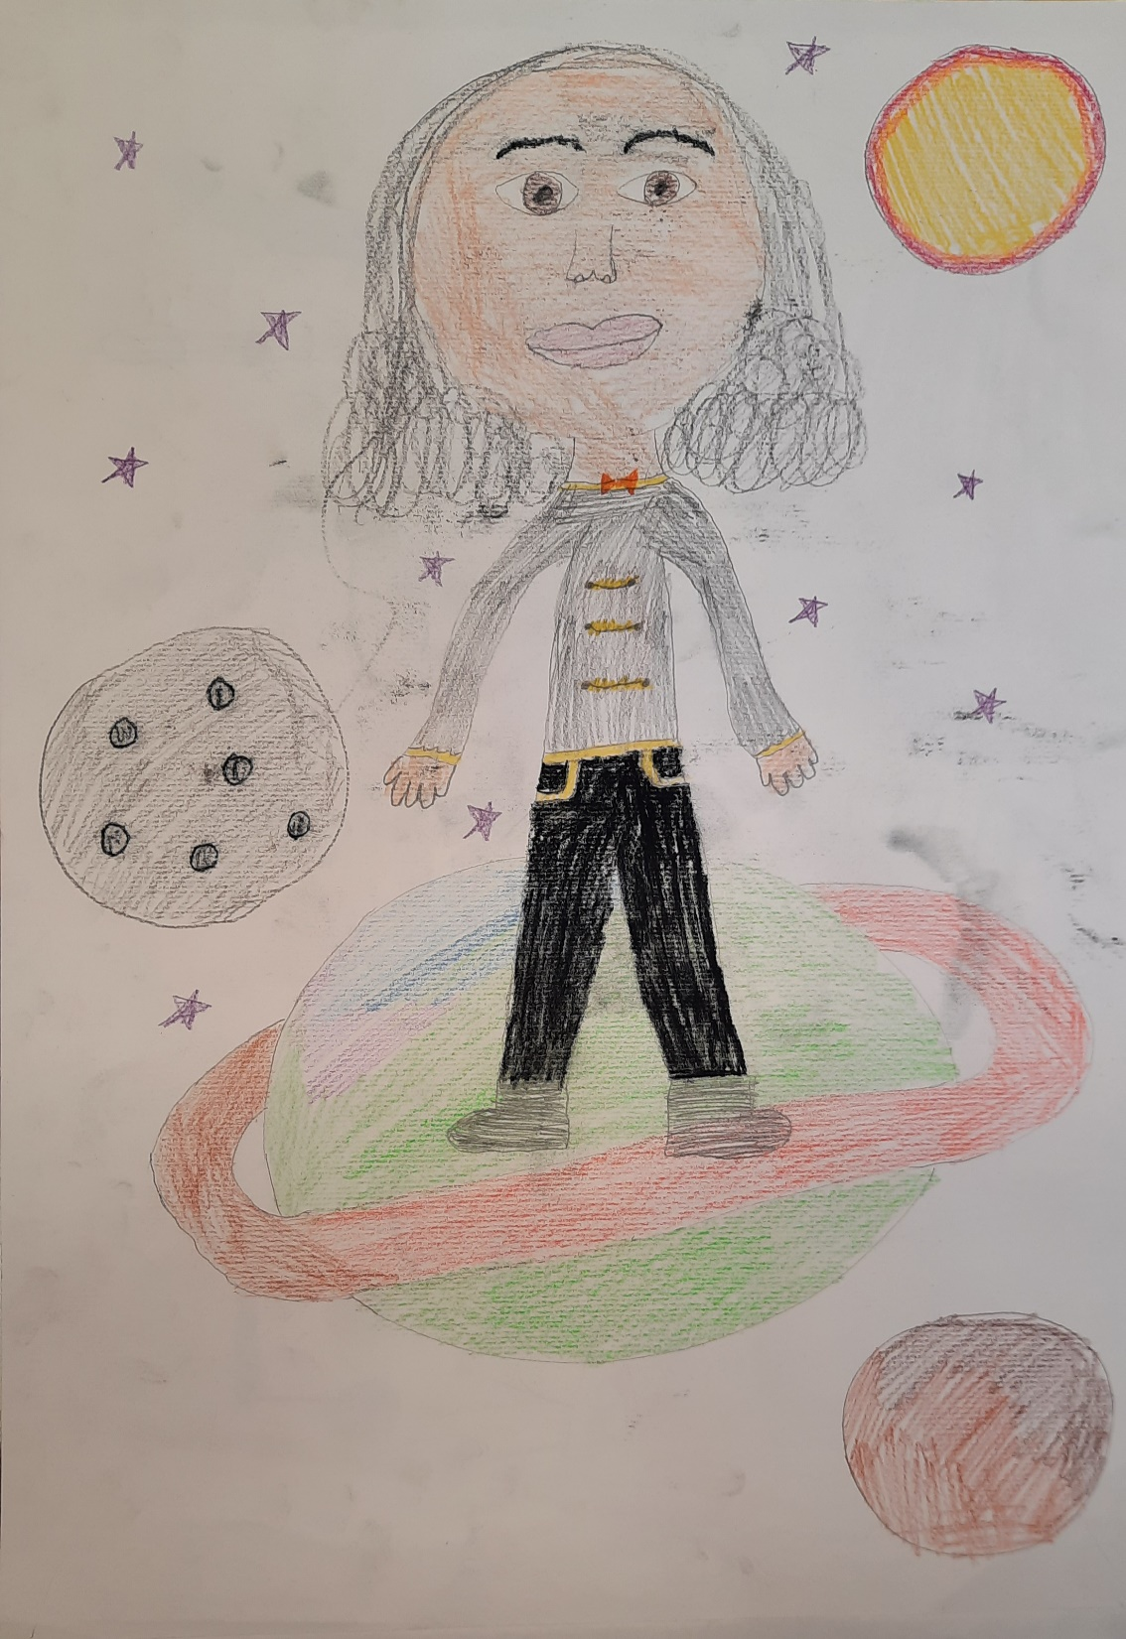
Tartini started a violin school “Scuola delle Nazioni”, which attracted students from all over Europe.

Slide 8
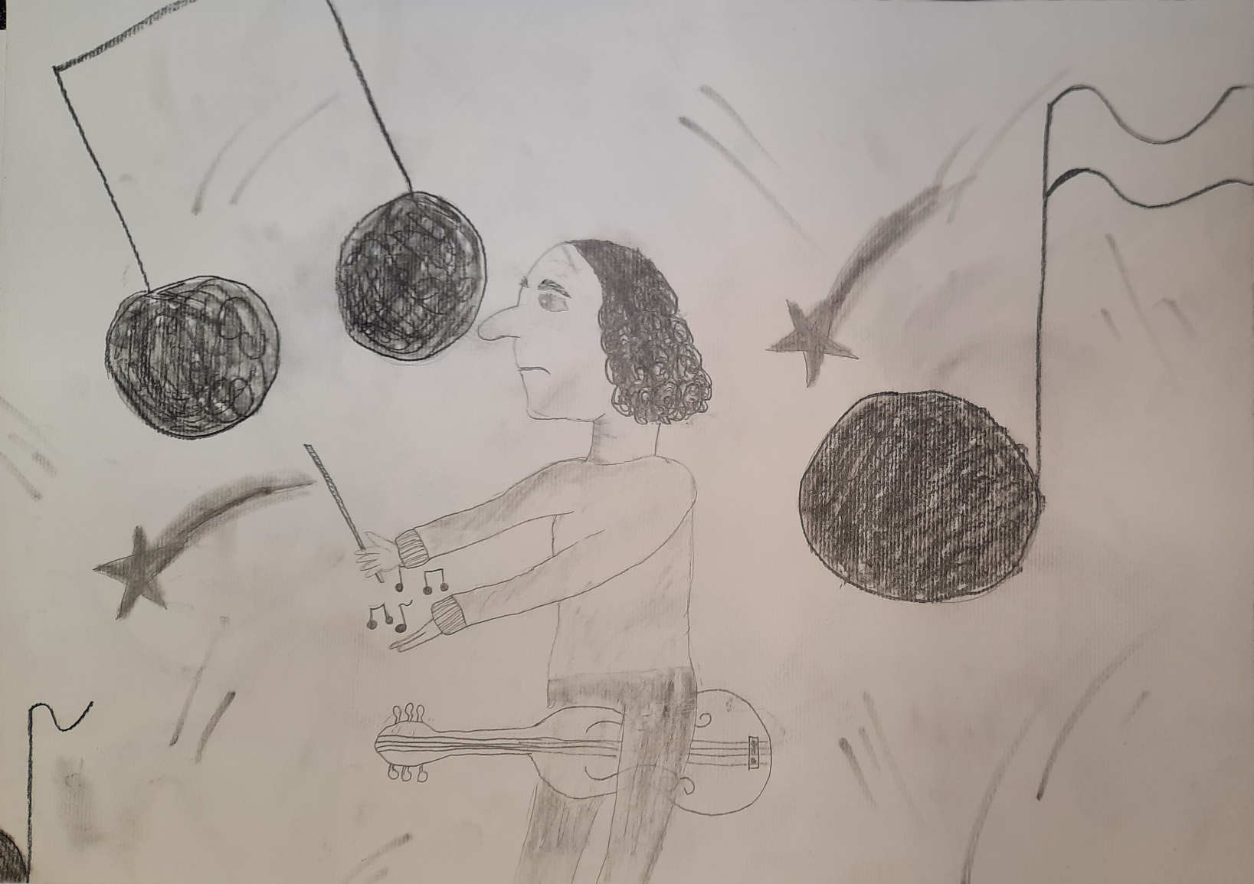
He died on 26th February 1770 in Padova.

Slide 9
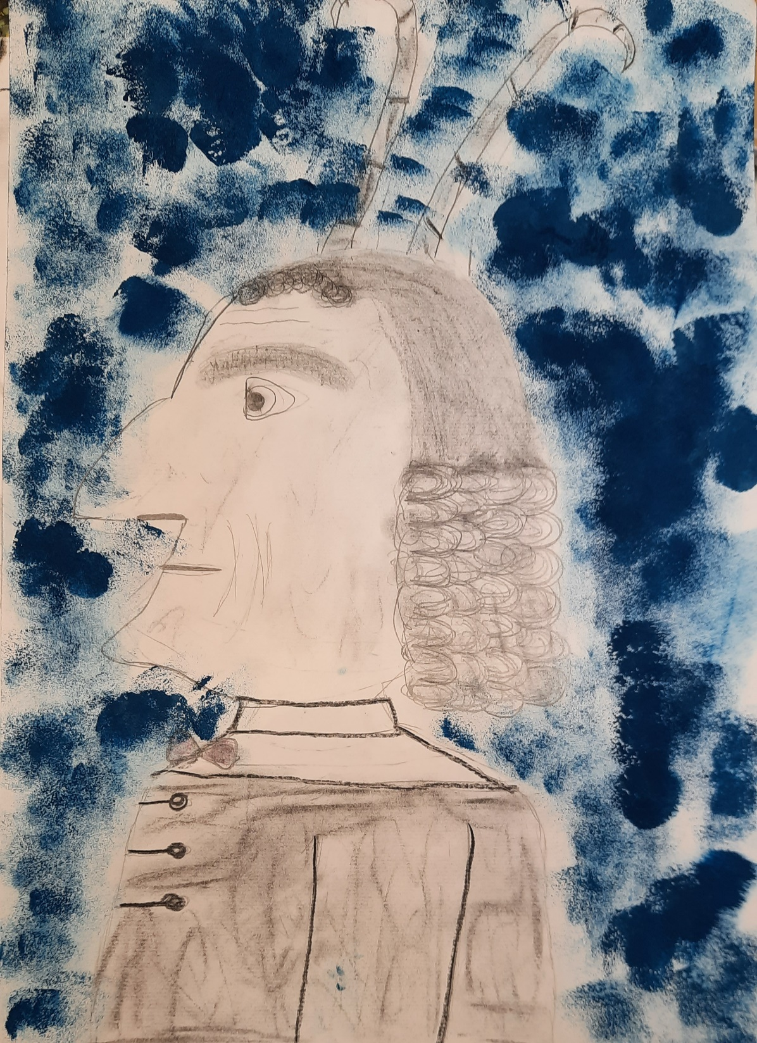
2022 is Tartini's year
(330 years since the birth of composer and violinist Giuseppe Tartini).

