Slide 1
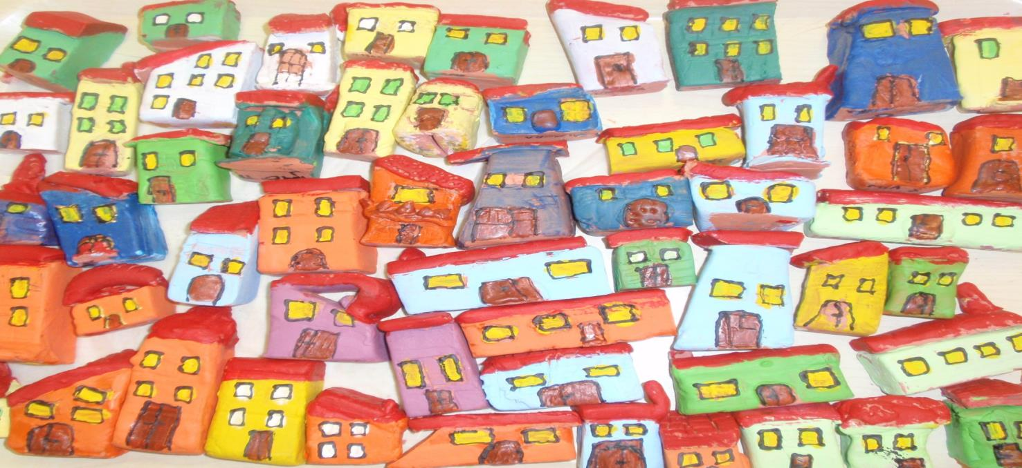
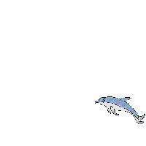
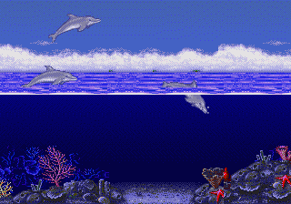
Cirila Kosmača Piran Primary school
SLOVENIA
DOLPHINES

Slide 2
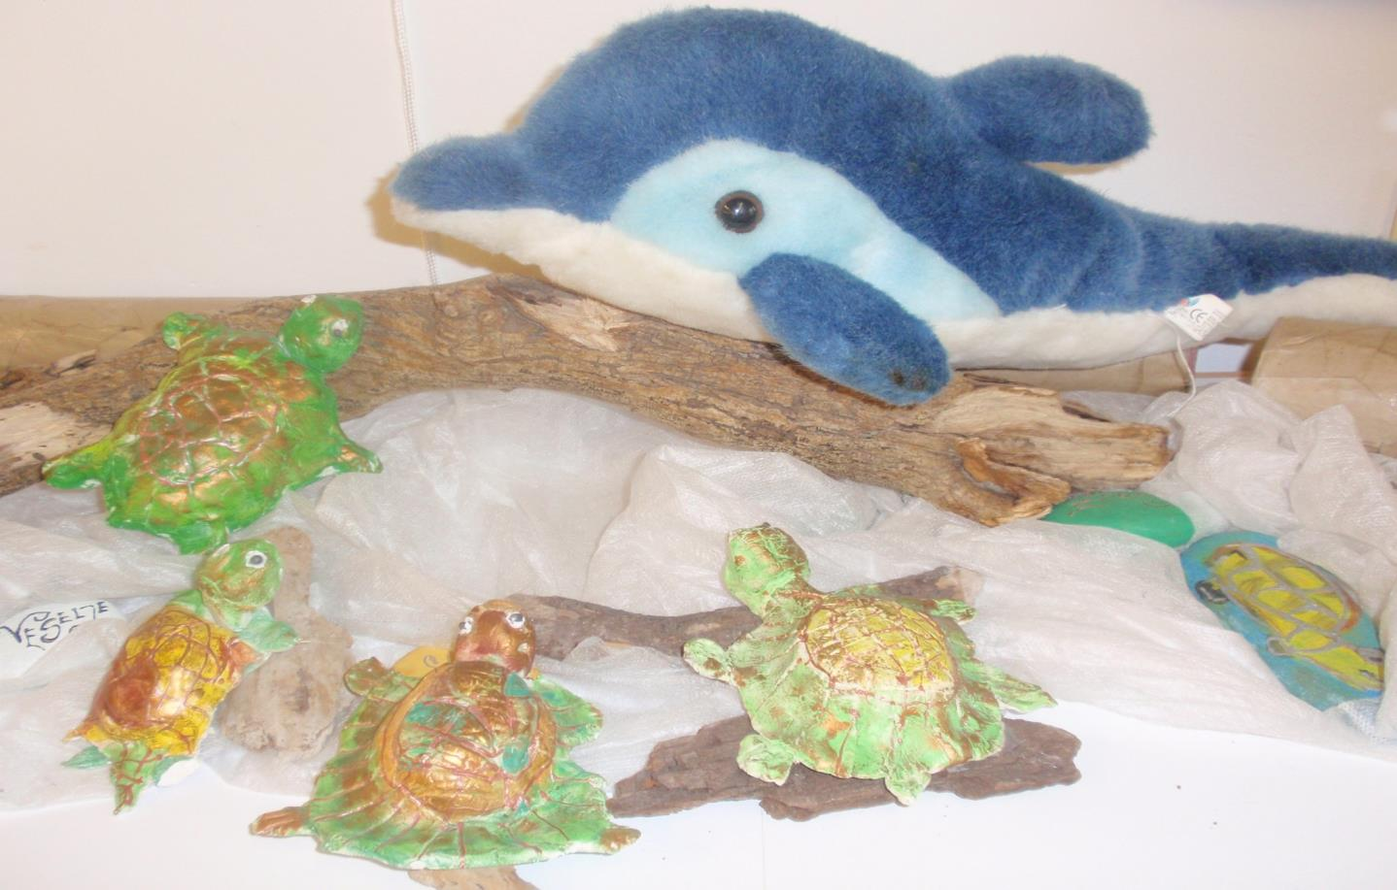
We explored our dolphins.
What did we discover?

Slide 3
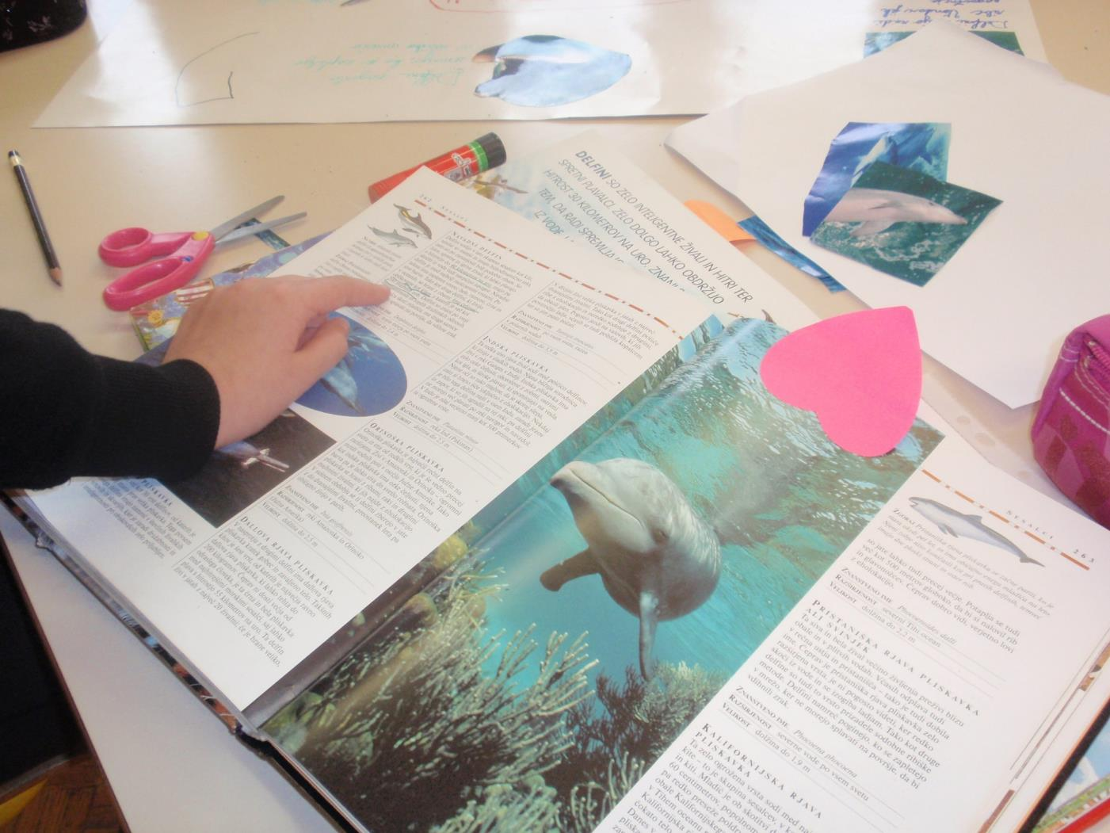
There are several types of dolphins.

Slide 4
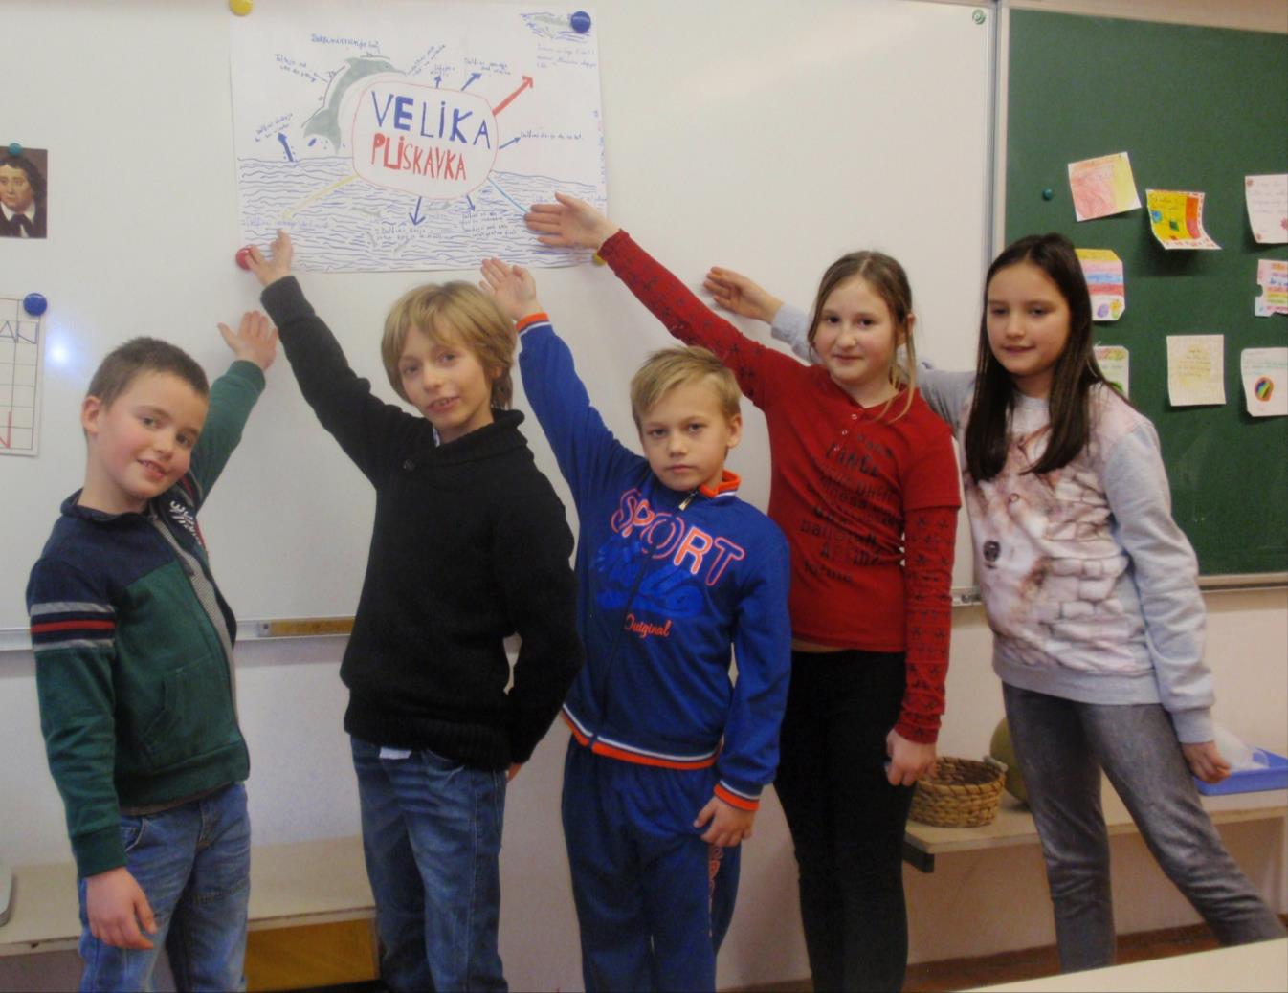
In our sea lives dolphins types
BOTTLENOSE DOLPHINS.

Slide 5
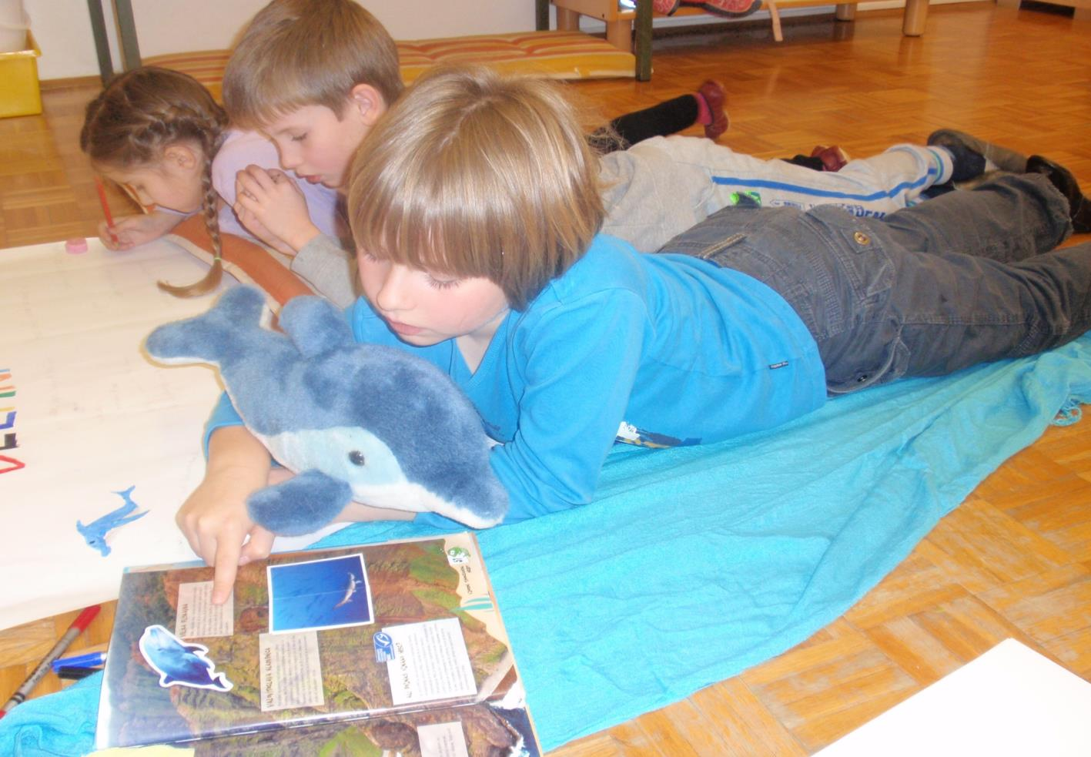
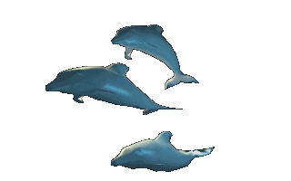
This type of dolphin is the most famous
and popular of all marine mammals.

Slide 6
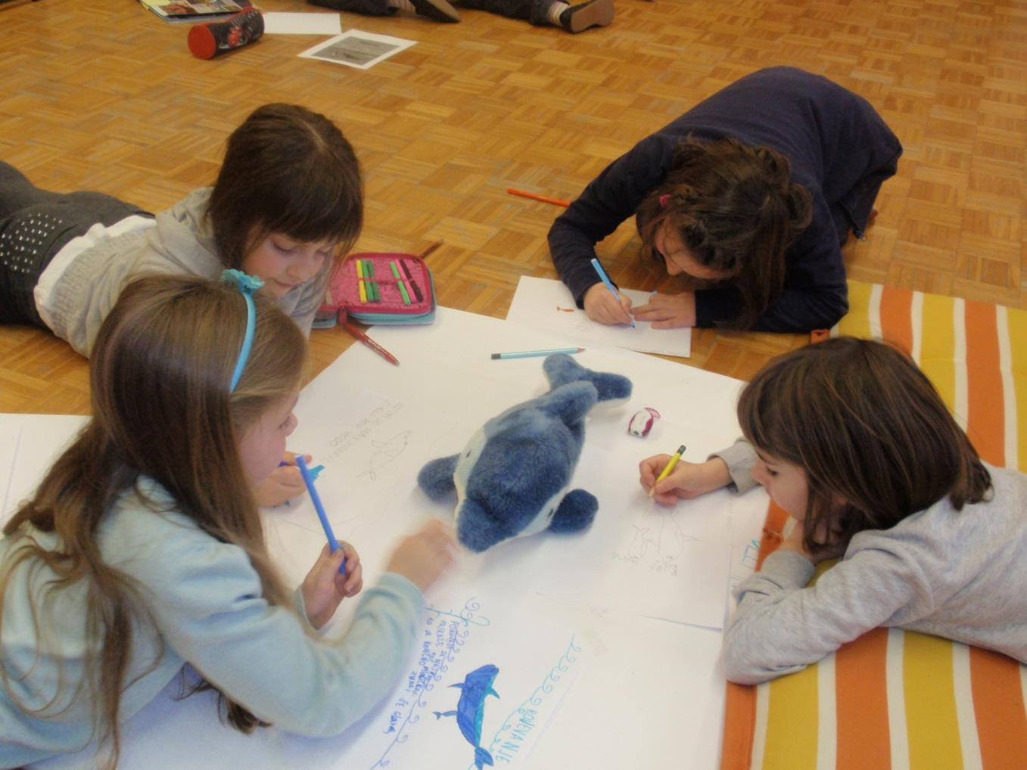

Slide 7
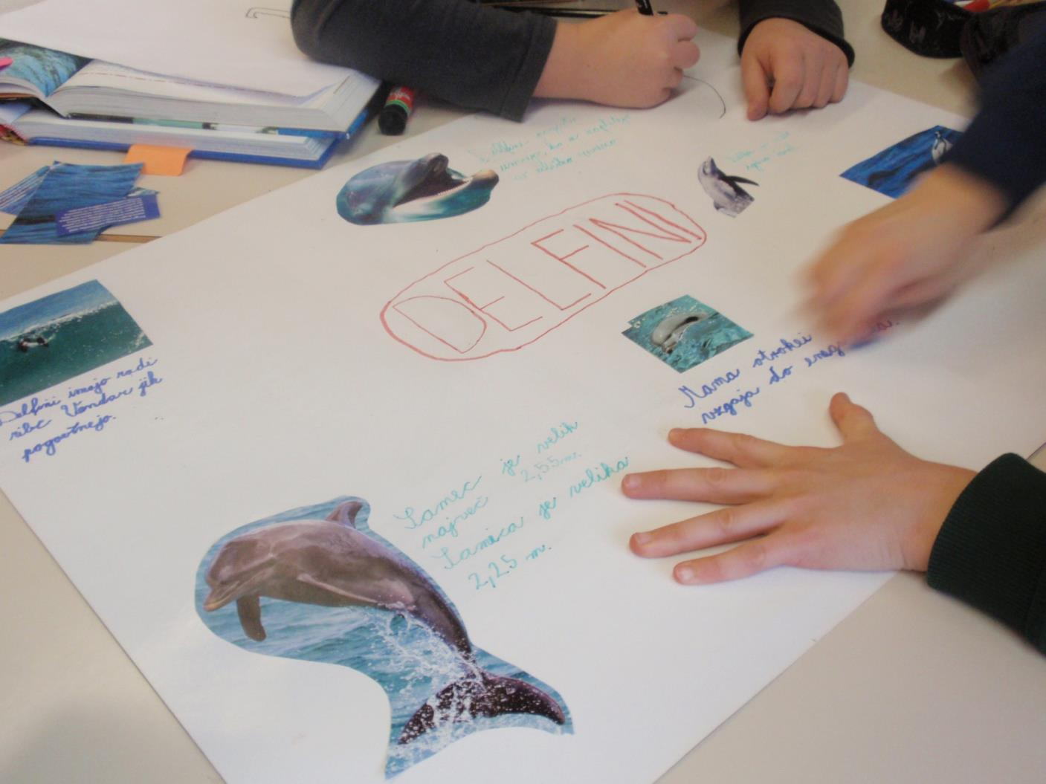

Slide 8
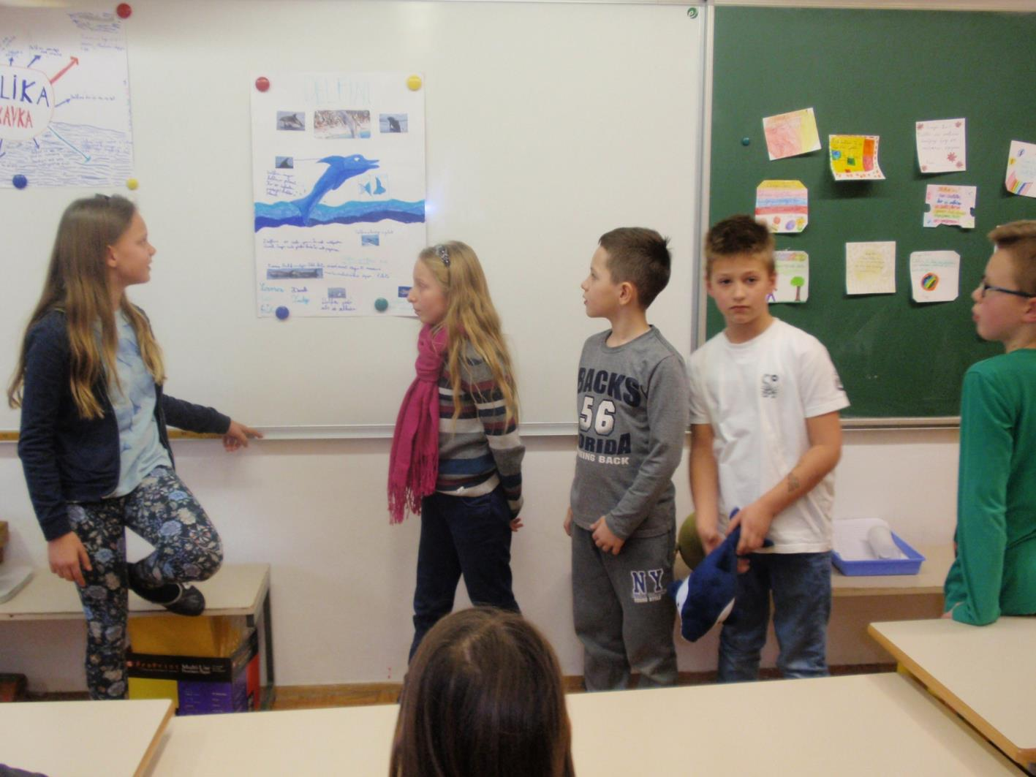
Males are from 2.4 to 3.8 m long
and weigh about 250 kg,
females measured from 2.4 to 3.7 m
and weigh about 190 kg.

Slide 9
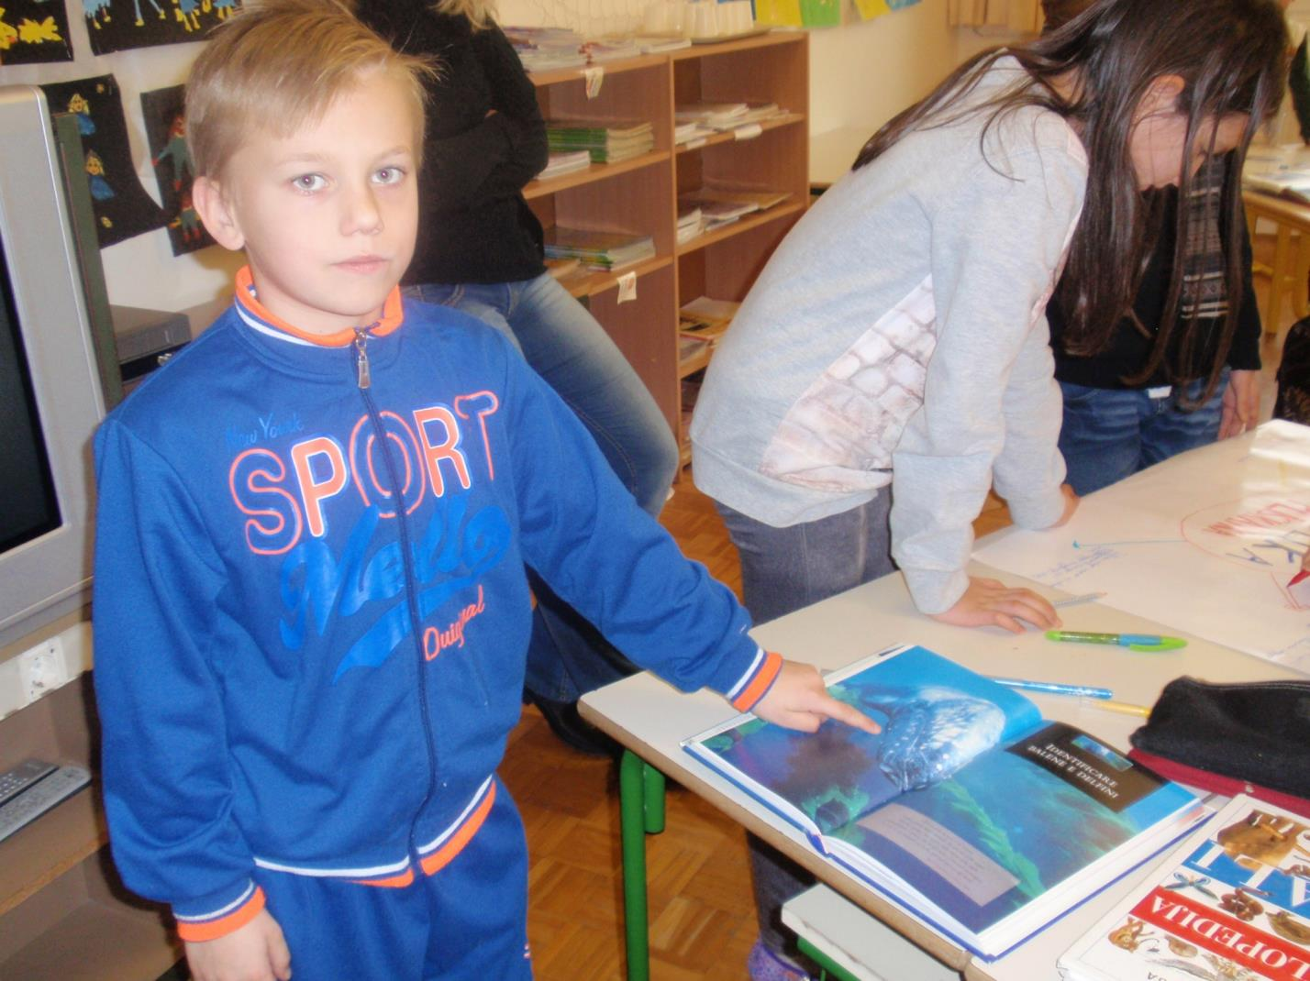
Dolphin can live as long as 40-50 years.

Slide 10
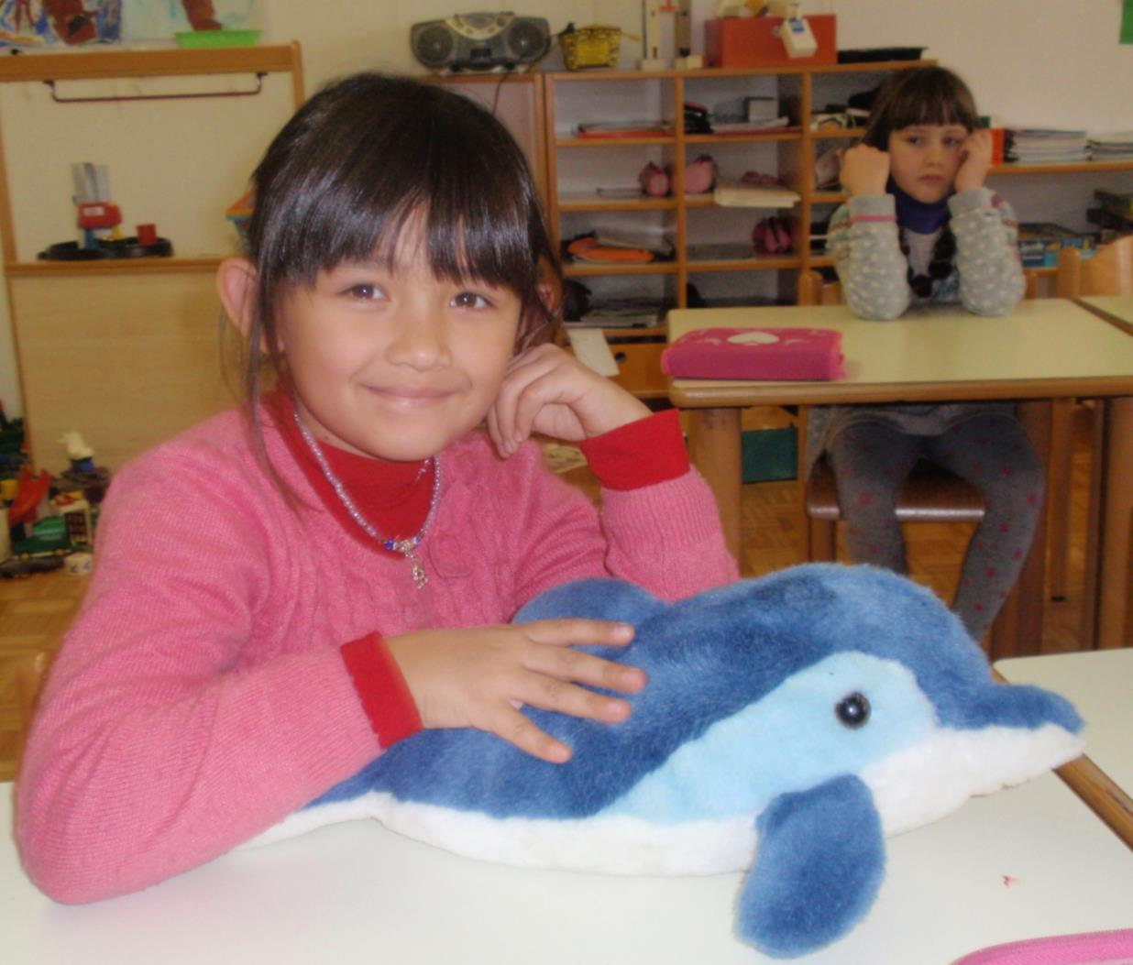
Bottlenose dolphins can see
well in the water and beyond.

Slide 11
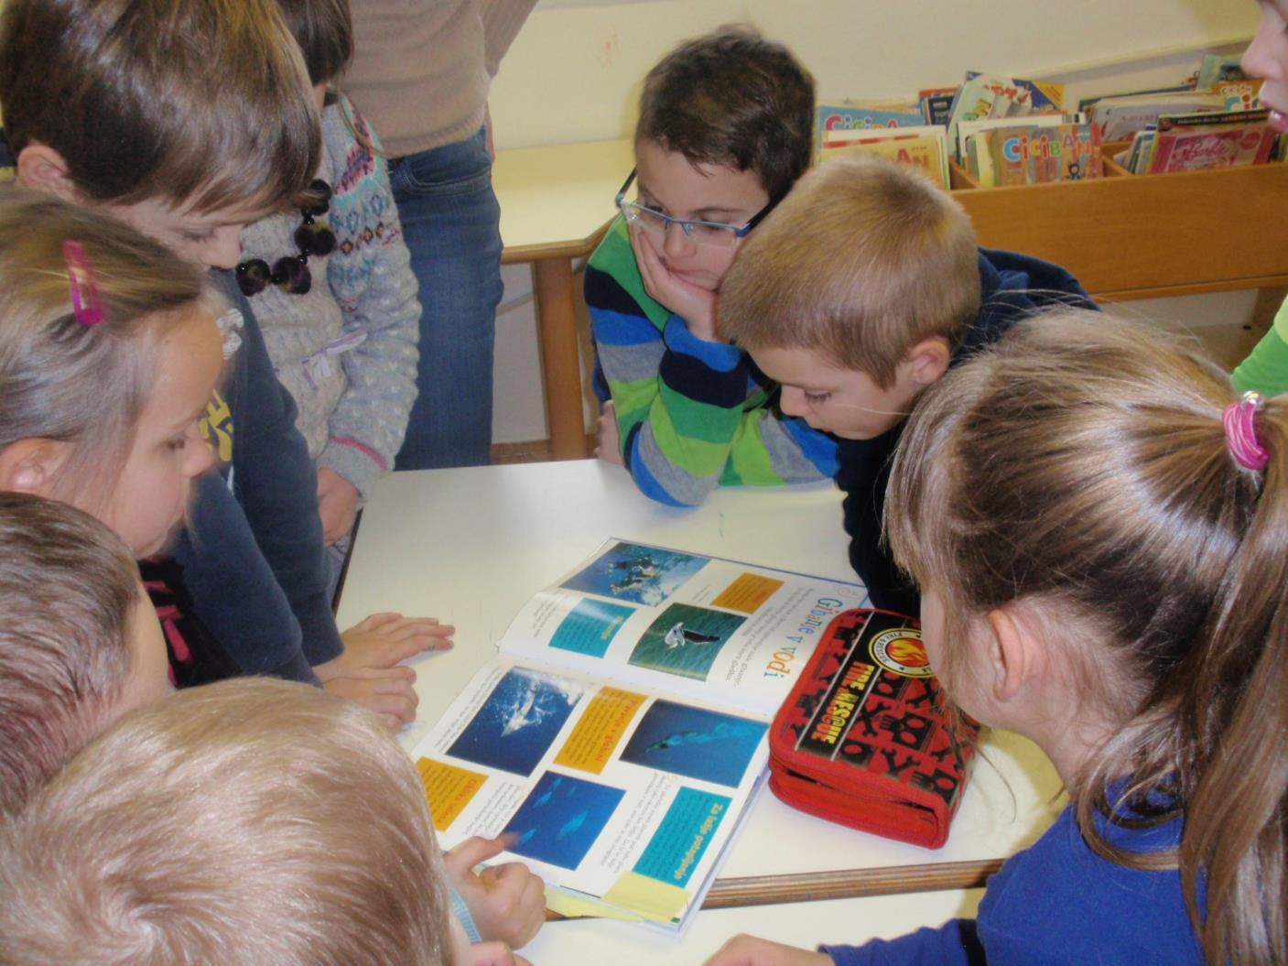
They produce three diferent
categories of sounds.

Slide 12
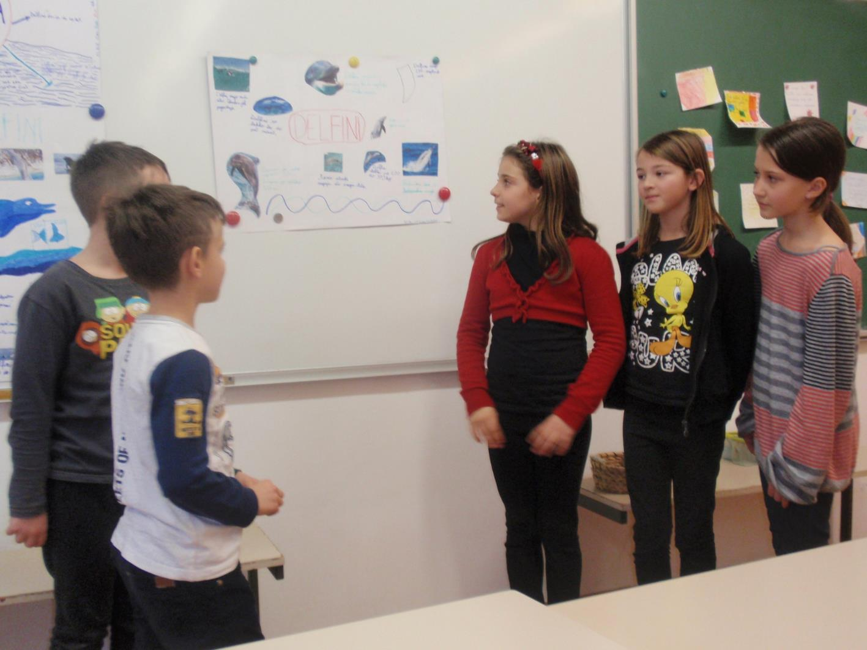
Bottlenose dolphins mating
mainly in spring or summer.

Slide 13
After ten or twelve months, pregnant females
give birth normally one cub.

Slide 14
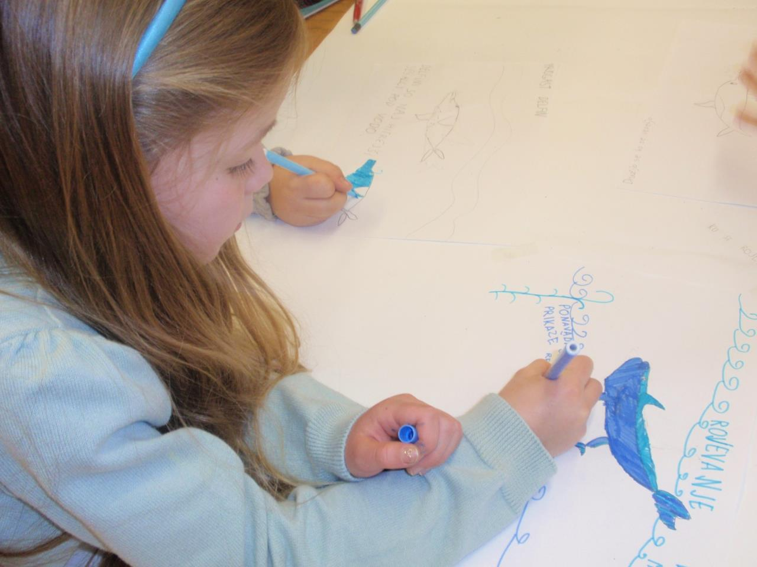
Some bottlenose populations live
closer to the shore (inshore populations)
and others live further out to sea (offshore populations).

Slide 15
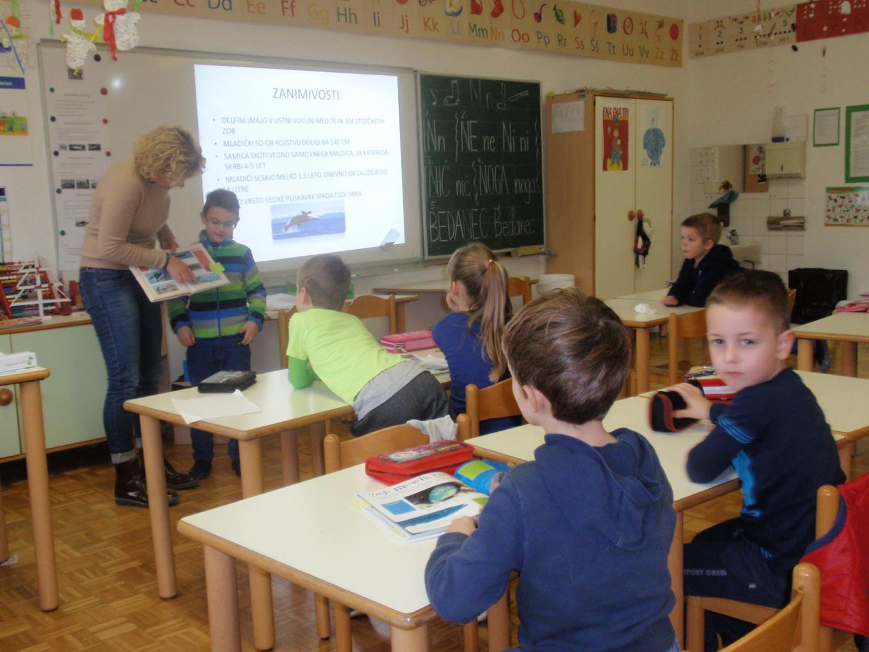
Dolphins help to each other!

Slide 16
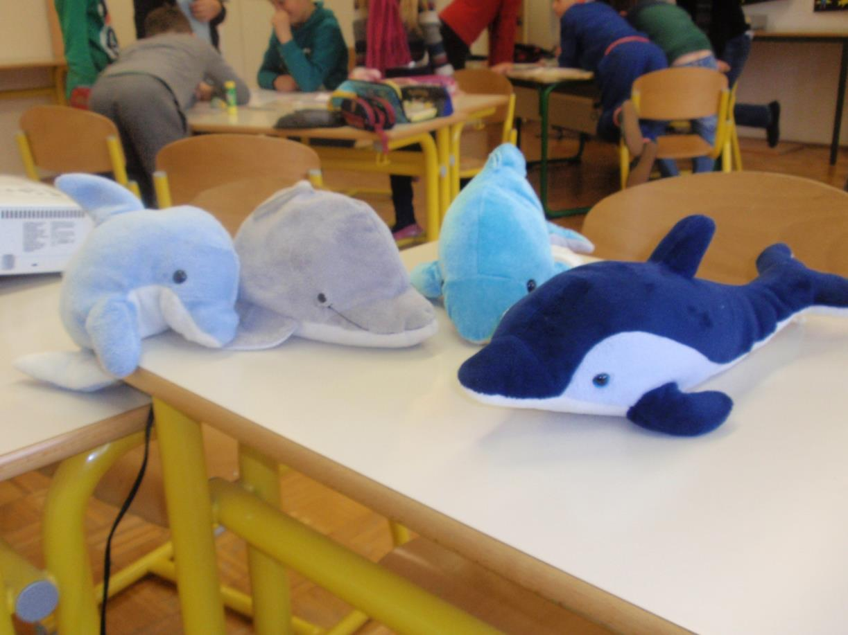
Dolphins move freely also the neighboring
Croatian and Italian sea –
for them there are no borders!

Slide 17
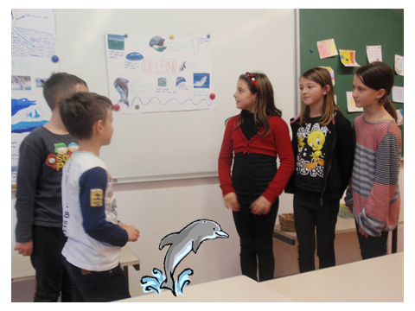
Prepared by students and teachers
of Branch school Portorož

